Slide 1
Banking Loan Analysis Dashboard

Slide 2
agenda
Data Integration and Preparation
Loan Portfolio Analysis
Deposit Portfolio Analysis
Engagement and Account Activity
Insights & Dashboard Presentation

Slide 3
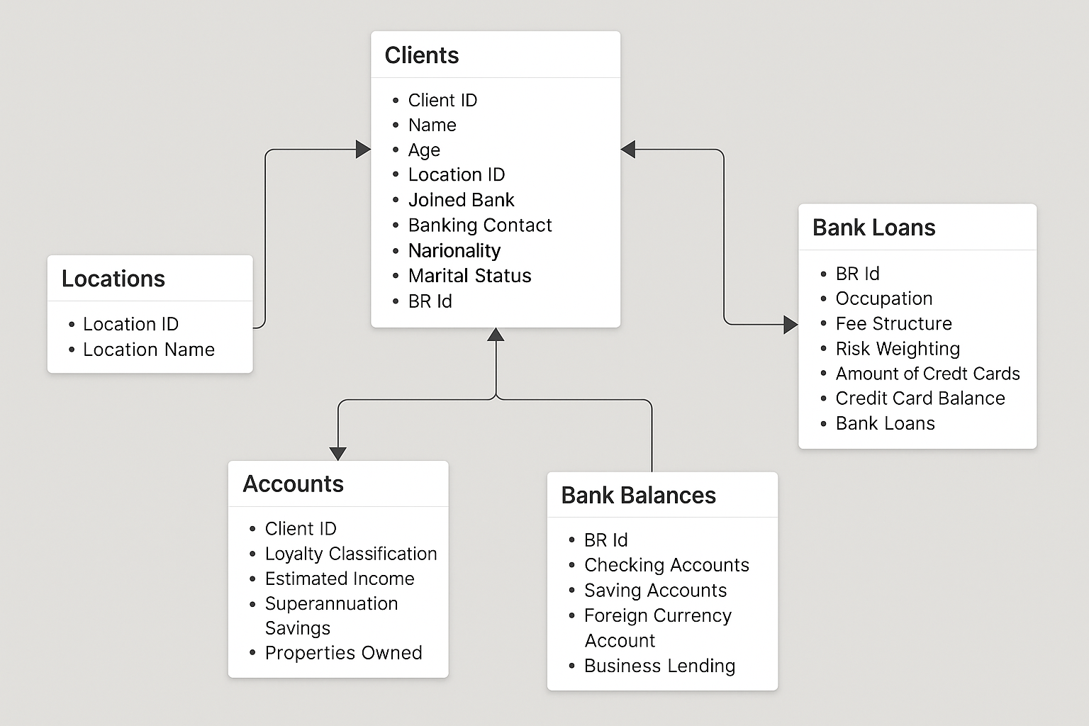

Slide 4



Loan Distribution Analysis
Total loans disbursed: ₹4.38bn
CC Balance
₹9.53M
Total Loan
₹4.38BN
Business Landing
₹2.60BN
The total lending portfolio demonstrates a strong consumer-driven focus, with Credit Cards accounting for $9.53M, significantly outpacing traditional Bank Loans ($4.38B) and Business Lending ($2.60B). This suggests high transactional activity and short-term borrowing behavior, while the substantial value in bank and business loans reflects long-term financial engagement and institutional trust

Slide 5
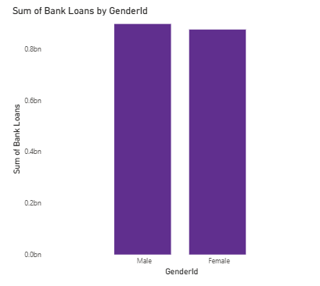
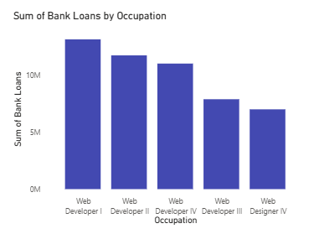
Loan Distribution by Demographics
The top 5 occupations by bank loan amount are all in web development and design, with Web Developer I leading in loan volume. This indicates strong financial engagement from IT professionals, particularly developers, possibly due to stable income profiles or higher creditworthiness in the tech sector.
Bank loan distribution is nearly equal across genders, with males holding a slightly higher loan amount. This indicates balanced access to credit facilities between male and female customers.

Slide 6
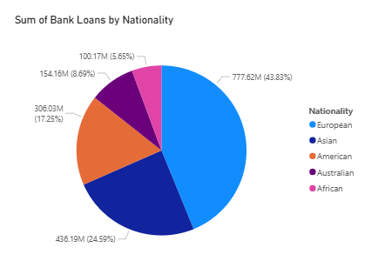
BANK LOAN BY NATIONALITY
European nationals account for the largest share of bank loans at 43.83%, followed by Asian (24.59%) and American (17.25%) clients. This suggests that European clients are the most financially engaged, possibly due to stronger credit profiles or higher loan accessibility in that demographic.

Slide 7



Deposit distribution analysis
Total Deposit
₹3.77bn
Saving Account Amt
₹698.73M
Checking Account Amt
₹963.28M
Total Deposits amount to ₹3.77 Billion, reflecting strong customer trust and engagement with banking services.
Checking Accounts lead with ₹963.28 Million, indicating high transactional activity.
Saving Accounts hold ₹698.73 Million, suggesting stable long-term saving behavior.
Together, Checking and Saving Accounts contribute over ₹1.66 Billion, representing a significant 44% share of total deposits.

Slide 8
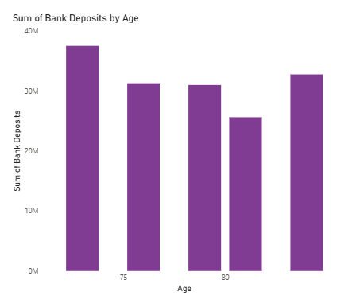
Top 5 Age Groups by Bank Deposits
Age ~70 holds the highest bank deposits, indicating strong financial activity or savings behavior
.
Ages 75 and 76 follow closely, maintaining significant deposit levels.
. Age 80 shows a drop in deposits, possibly due to reduced income or retirement-related factors.
.Overall, the 70–76 age group dominates in deposit contributions.
. This trend highlights that early senior years are peak periods for banking deposits.
. Let me know if you’d like these turned into slide points or added to your report.

Slide 9
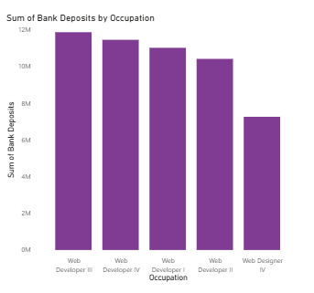
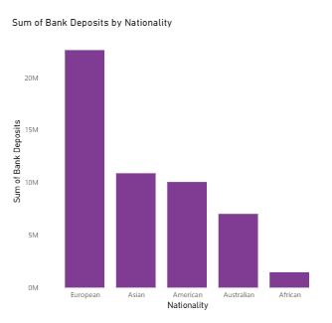
Bank deposit by occupation
.
Web Developer III leads in bank deposits, indicating strong financial involvement.
Web Developer IV and I follow closely, showing consistent deposit behavior across developer levels.
Web Developer II also maintains a high deposit level, just slightly behind.
Web Designer IV ranks lowest among the top 5, suggesting comparatively lower deposit contributions from design roles.
European customers contribute the highest deposits, showing strong financial stability.
Asian and American nationals follow with moderate deposit levels.
Australians have lower deposit contributions in comparison.
Africans contribute the least, indicating minimal deposit activity among this group.

Slide 10
Challenges Faced & Solutions Implemented
1. Data Connectivity Issues Problem: Difficulty connecting Power BI to MySQL due to missing components. Solution: Installed required MySQL connector to enable seamless data import into Power BI.
2. Data Cleaning & Preparation Problem: Inconsistent and unstructured data (e.g., incorrect data types, missing values). Solution: Used Power Query to clean, transform, and standardize data for analysis.
3. Complex Metrics Calculation Problem: Need to create new KPIs like Total Bank Loan and Total Engagement Accounts. Solution: Created calculated columns and DAX measures to combine multiple account types logically.
4. Visual Overload & Clarity Problem: Too many visuals could overwhelm the audience. Solution: Used focused charts per category (Gender, Age, Nationality, Occupation), with clear titles and insights for each.
5. Insightful Storytelling Problem: Difficulty turning raw data into meaningful insights. Solution: Used visuals like pie charts and bar graphs, and wrote concise insights for better interpretation and reporting.

Slide 11
Final Conclusion
The analysis reveals that Credit Cards, Bank Loans, and Business Lending are the top contributors to the bank's loan portfolio, totaling over ₹16.51 billion.
European nationals dominate both loan and deposit categories, indicating a strong financial engagement with the bank.
Web Developers across various levels are key contributors in both loans and deposits.
The 75+ age group holds significant deposits, showcasing the importance of senior customers.
Gender-based loan distribution is nearly equal, indicating no strong gender bias in loan approval.

Slide 12
💡 Suggestions
Target High-Value Customers: Focus marketing on Web Developers and European customers for tailored loan and deposit products.
Strengthen Senior Banking Services: Offer attractive deposit schemes for older age groups.
Enhance Digital Engagement: Introduce digital solutions to encourage more Saving and Checking account activities.
Monitor Credit Risk: Closely track credit card and business lending segments due to their high value and associated risk.
Data Expansion: Integrate more demographic and transactional data for deeper insights in future analyses.

Slide 13
Thank you
Bishakha Kapur
Email: bishakhakapur7@gmail.com

